Slide 1


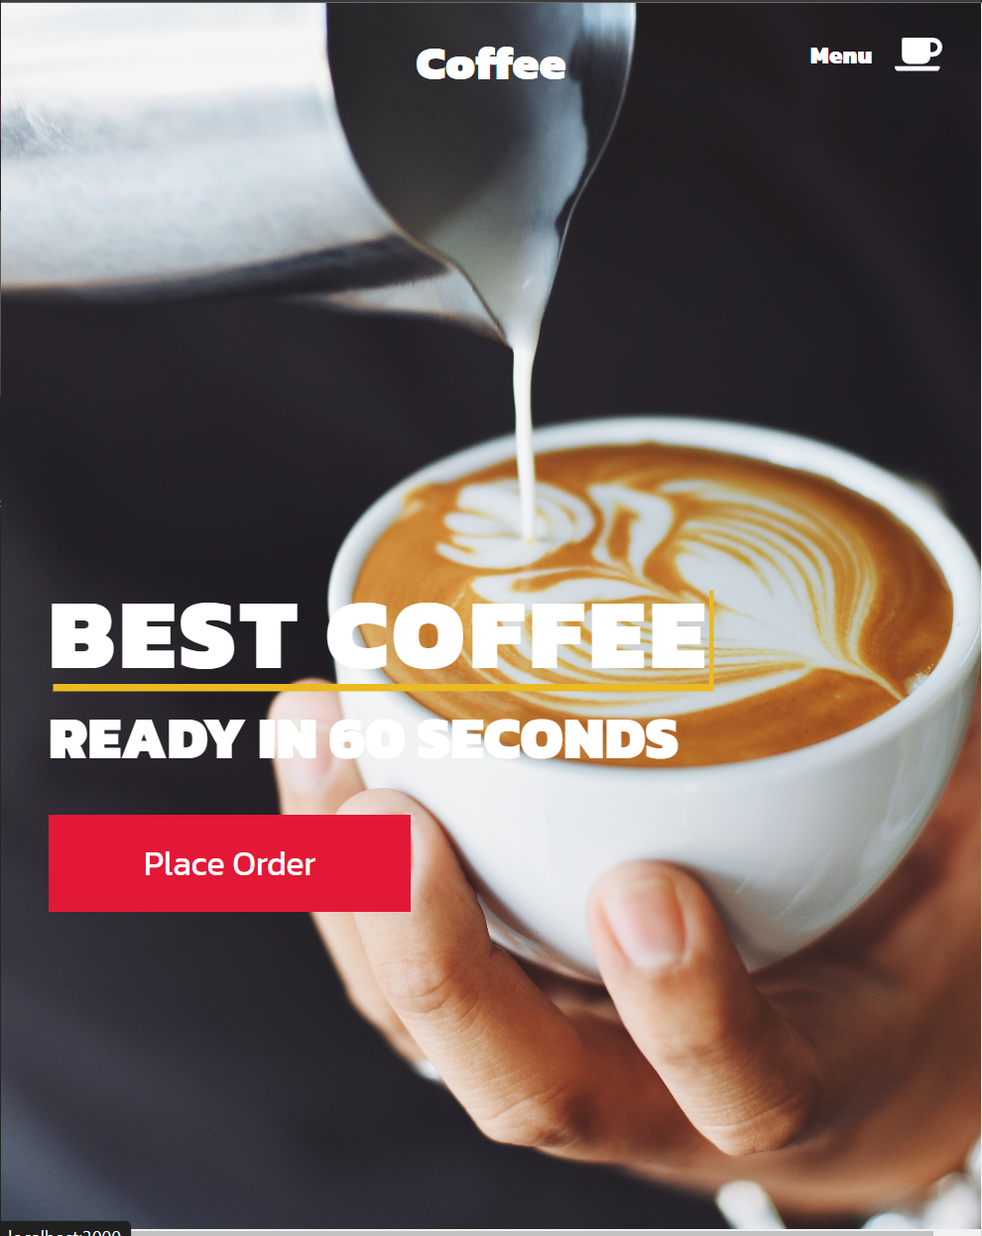
Operation
527
Restaurant Portfolio:
WCAG Presentation

Slide 2
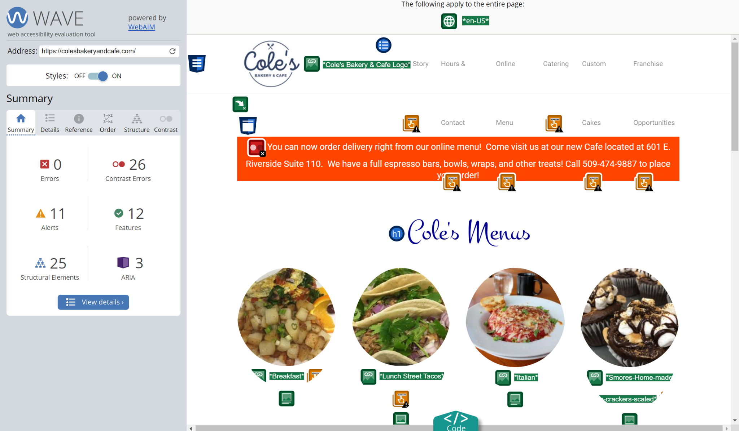
#1: Color Contrast
Link: https://wave.webaim.org/report#/https://colesbakeryandcafe.com/
As gone over in the video we want to make sure our color design is not affecting the readability of our website for anyone to make it the most accessible.
The tools we will be using is the checker they displayed in the video we ran the contrast checker on the current website and it found a lot of things that could be improved we will use this tool on our website when finished to help use make sure that it is readable for everyone.
Some challenges we may face with implementation of this is we may have to switch our original color scheme to fix some of the issues with readability found on the main website.

Slide 3
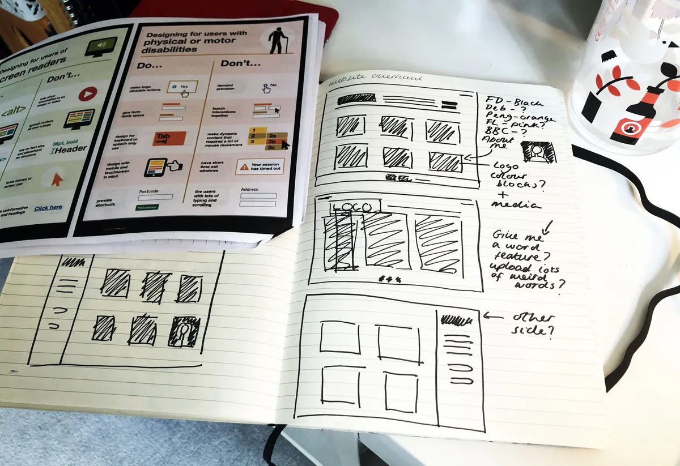
#2: Clear Layout and Design
Simply put, bad design and layout is a frequent issue that websites struggle with, and can impact accessibility for lots of people. Which is one of the reasons why we wanted to re-due the existing website.
To ensure this isn’t an issue with our website, we will ensure to provide:
Clean and consistent navigation options
Interactive elements that are easy to identify
Form elements that include clearly associated labels
Content that appears and operates in predictable ways
While lots of people can critique the look and feel of a webpage, it is another thing to create and design it yourself. We might run into roadblocks when it comes to ensuring the layout and design is as we want, and staying consistent.

Slide 4
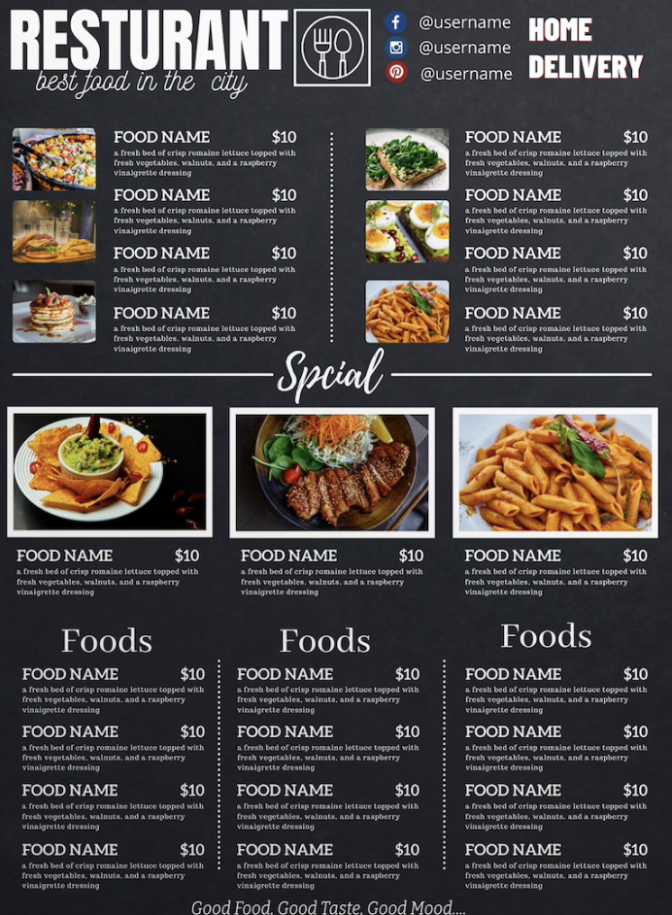
#3: Content is readable and understandable
Guideline 3.1 of the Web Content Accessibility Guidelines (WCAG) focuses on making content readable and understandable for all users, regardless of their abilities or disabilities.
To ensure this isn’t an issue with our website, we will:
Use simple and straightforward language
Use a readable font
Provide images to clarify the menu options
Some challenges we may face is not being able to provide images for all the menu options because it might make the aesthetics of the website not as appealing. We will provide image for the more popular menu options.

Slide 5

Keyboard Accessible
WCAG guidelines specify that all of the content on a website is accessible through the keyboard and it should not need specific timing of keystrokes.
So far all of the components on our site are keyboard accessible and can be selected using nothing but the keyboard. We will continue to make sure new components are keyboard accessible by including proper tags and setting the tabbing order to follow the flow of the website.
Some challenges we may face is that some components may be hard to design in a keyboard accessible way that is both functional but also has a good user experience.

Slide 6
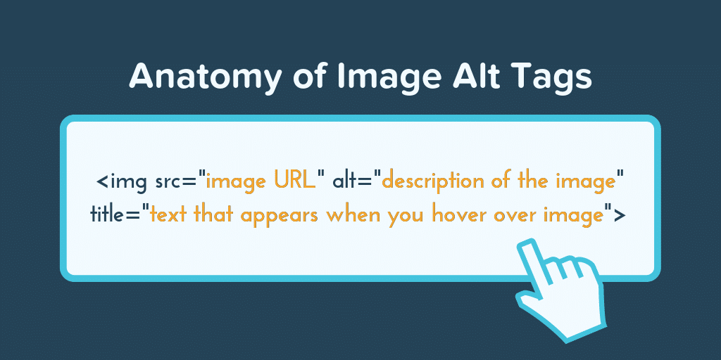
#5: Describing the terms in the photo
The WCAG guidelines for the anatomy of and image is “If the image is not a logo, avoid text in images. However, if images of text are used, the text alternative should contain the same words as in the image.” exact quote.
We will design our website to have proper Alt tags to describe each and every image for the visually impaired. We will make sure they can order food by using screen readers to help them read the screen.
Challenges we may face are the amount if photos we will have to add terms for visually impaired because there are going to be many different options on a menu. Also making sure each and every dish is properly described.

Slide 7
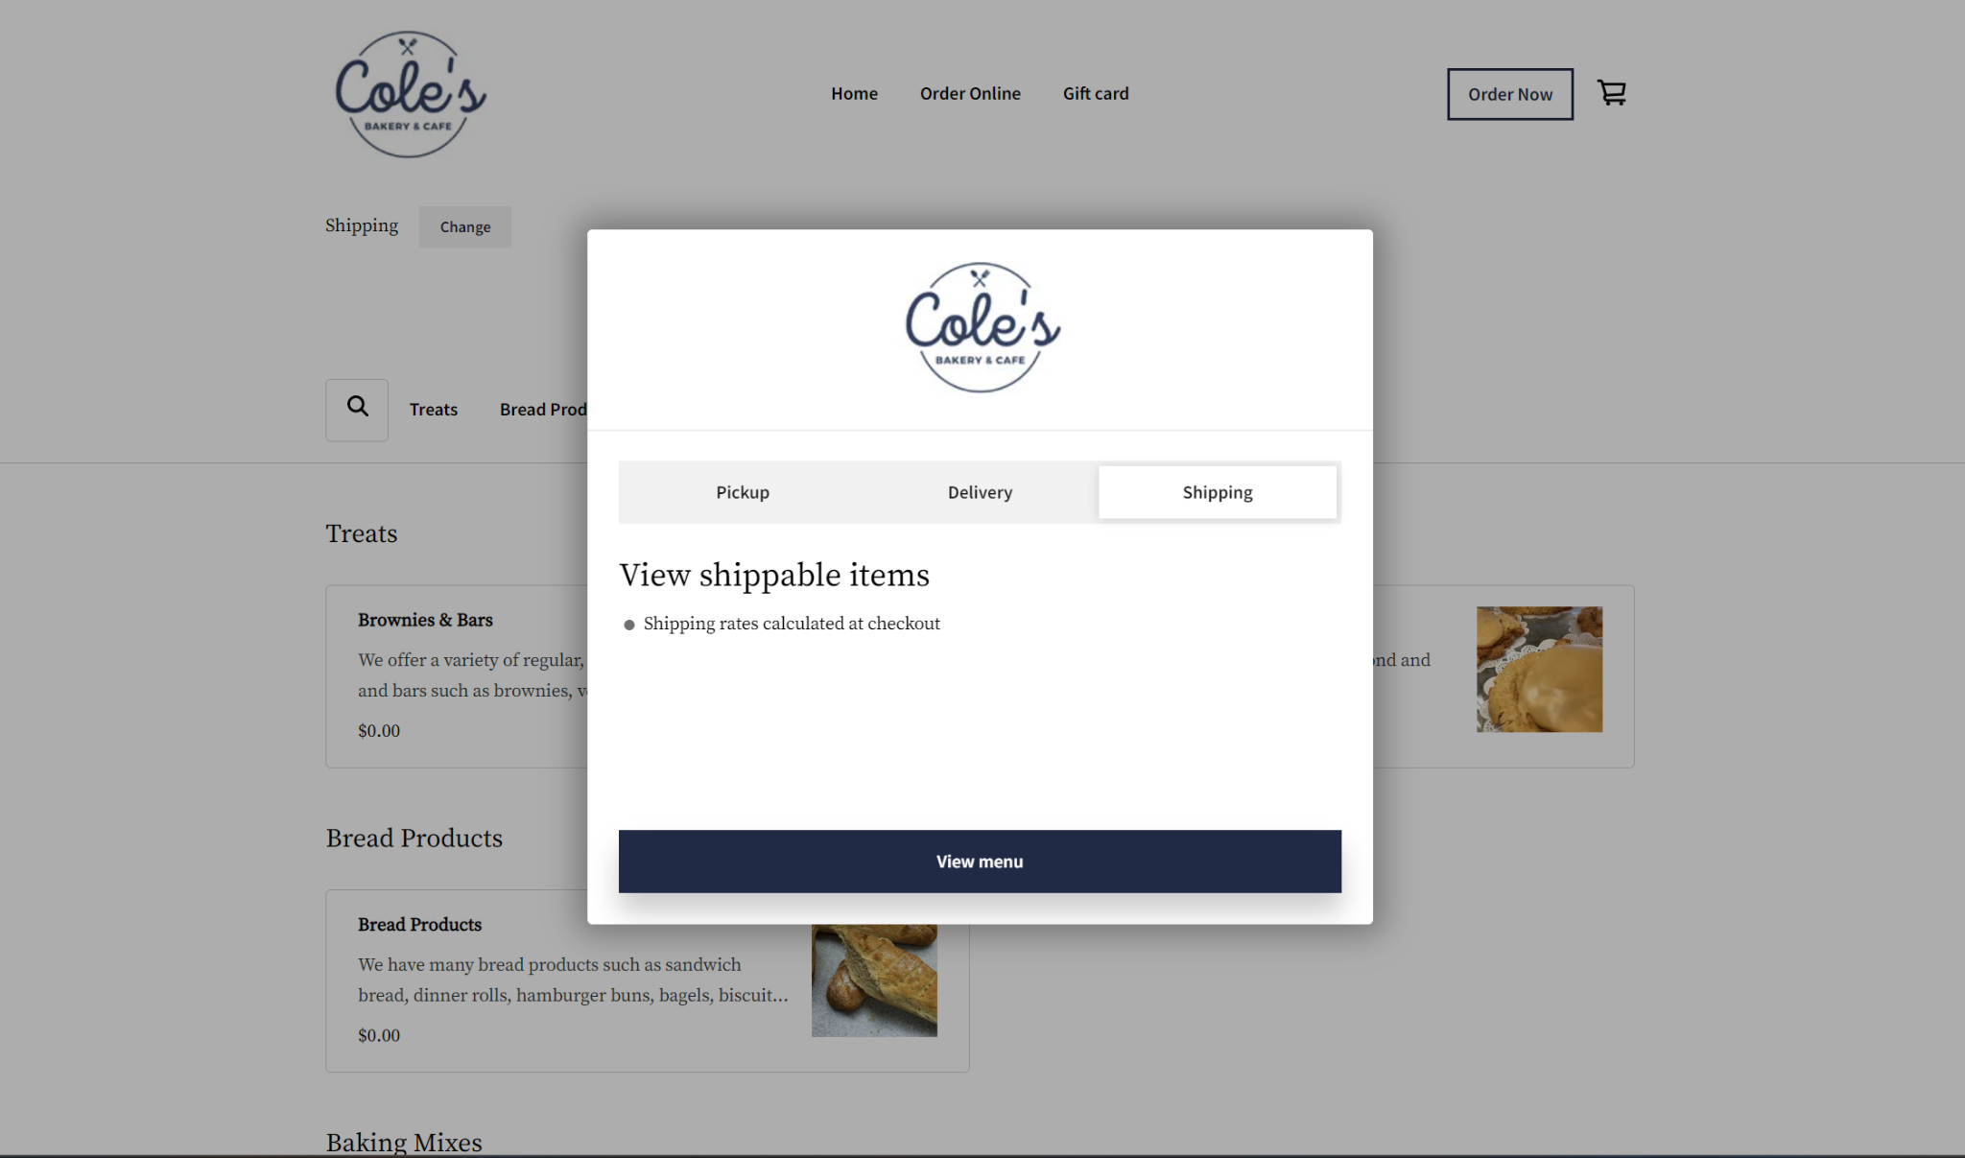
Conclusion:
It will be nice to make our site more accessible than the original that we reviewed that is quite inaccessible in many ways like the ordering system, color contrasts, multiple different websites. In the end our goal is to create a website that is more accessible to anyone and address the needs of the people who use our website.

